Slide 1
Testing HH’s
21/11/2020

Slide 2
Solvers Representation
1.- Longest Processing Time (LPT)
2.- Shortest Processing Time (SPT)
3.- Most Pending Activities (MPA)
4.- Least Pending Activities (LPA)
Heuristic Ids:
1.- LPT
2.- SPT
3.- MPA
4.- LPA

Slide 3
First HH to test
Displaying information about the New HH:
Target problem: JSSP
Type: Rule-based
Training method: Undefined
Number of instances: 0 (training) | 0 (testing)
Current method:
0 0 0 0 0 1
1 1 1 1 1 2
Solvers
Heuristic Ids:
1.- LPT
2.- SPT
3.- MPA
4.- LPA

Slide 4
Testing Instance
Processing Times
Machine Id’s
10 | 2 | 5 | 4
3 | 8 | 1 | 7
9 | 6 | 4 | 5
1 | 3 | 3 | 4
4 | 1 | 3 | 2
1 | 4 | 2 | 3
J1
J1
J2
J2
J3
J3
Mirsh175 | Mirsh15 | Mirsh29 | Mirsh282| Mirsh95
Initial Features: 0.0732 0.0682 0.2311 0.2963 0.0833
Notes:
So first step should be with LPT

Slide 5
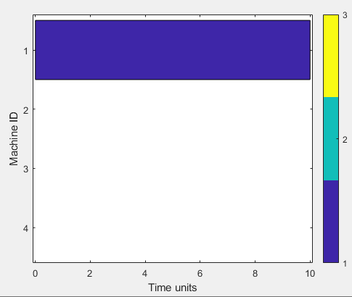
First Step
HHprueba.step(TestingInstance)
ans(:,:,1) =
0 2 5 4
3 8 1 7
9 6 4 5
ans(:,:,2) =
0 3 3 4
4 1 3 2
1 4 2 3
Mirsh175 | Mirsh15 | Mirsh29 | Mirsh282| Mirsh95
Updated Features: 0.0191 0.2106 0.0932 0.2963 0.0417
Notes:
With these features, LPT should be selected again, so third job should be selected.

Slide 6
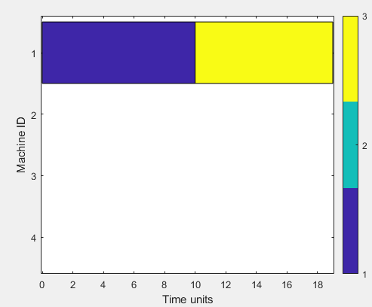
Second Step
HHprueba.step(TestingInstance)
ans(:,:,1) =
0 2 5 4
3 8 1 7
0 6 4 5
ans(:,:,2) =
0 3 3 4
4 1 3 2
0 4 2 3
Mirsh175 | Mirsh15 | Mirsh29 | Mirsh282| Mirsh95
Updated Features: 0.0208 0.1541 0.1050 0.4074 0.0417
Notes:
With these features, LPT should be selected again, so third job should be selected.

Slide 7
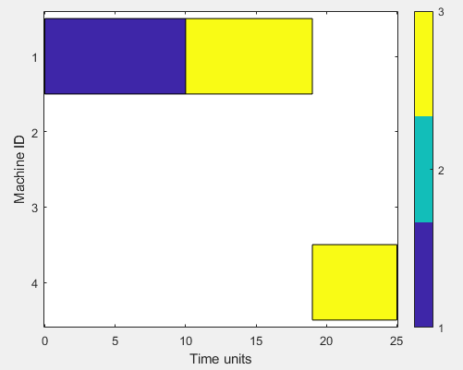
Third Step
HHprueba.step(TestingInstance)
ans(:,:,1) =
0 2 5 4
3 8 1 7
0 0 4 5
ans(:,:,2) =
0 3 3 4
4 1 3 2
0 0 2 3
Mirsh175 | Mirsh15 | Mirsh29 | Mirsh282| Mirsh95
Updated Features: 0.0216 0.2353 0.1412 0.4815 0.0417
Notes:
With these features, LPT should be selected again, so second job should be selected.

Slide 8
Second HH to test
Displaying information about the New HH:
Target problem: JSSP
Type: Rule-based
Training method: Undefined
Number of instances: 0 (training) | 0 (testing)
Current method:
0 0 0 0 0 1.0000
0.2500 0.2500 0.2500 0.2500 0.2500 2.0000
0.5000 0.5000 0.5000 0.5000 0.5000 3.0000
0.7500 0.7500 0.7500 0.7500 0.7500 4.0000
Heuristic Ids:
1.- LPT
2.- SPT
3.- MPA
4.- LPA

Slide 9
Testing Instance
Processing Times
Machine Id’s
10 | 2 | 5 | 4
3 | 8 | 1 | 7
9 | 6 | 4 | 5
1 | 3 | 3 | 4
4 | 1 | 3 | 2
1 | 4 | 2 | 3
J1
J1
J2
J2
J3
J3
Mirsh175 | Mirsh15 | Mirsh29 | Mirsh282| Mirsh95
Initial Features: 0.0732 0.0682 0.2311 0.2963 0.0833
Distance to each rule: 0.3977 0.3075 0.8100 1.3574
LPT | SPT | MPA | LPA
Notes:
So first step should be with SPT, whic means that Job 2 should be selected.

Slide 10
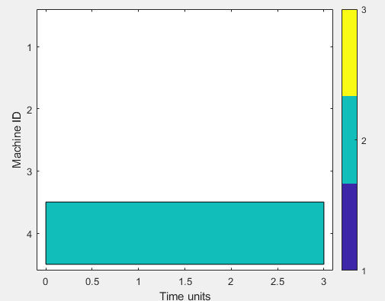
First Step
HHprueba.step(TestingInstance)
ans(:,:,1) =
10 2 5 4
0 8 1 7
9 6 4 5
ans(:,:,2) =
1 3 3 4
0 1 3 2
1 4 2 3
Mirsh175 | Mirsh15 | Mirsh29 | Mirsh282| Mirsh95
Updated Features: 0.0704 0.1149 0.2601 0.3704 0.0833
Distance to each Rule: 0.4795 0.3047 0.7621 1.3014
LPT | SPT | MPA | LPA
Notes:
With these features, SPT should be selected again, so second job should be selected.

Slide 11
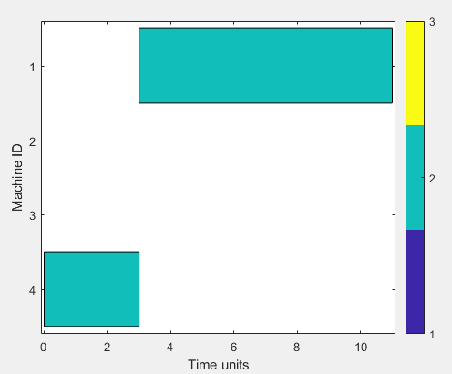
Second Step
HHprueba.step(TestingInstance)
ans(:,:,1) =
10 2 5 4
0 0 1 7
9 6 4 5
ans(:,:,2) =
1 3 3 4
0 0 3 2
1 4 2 3
Mirsh175 | Mirsh15 | Mirsh29 | Mirsh282| Mirsh95
Updated Features: 0.0737 0.2783 0.1521 0.4815 0.0833
Distance to each Rule: 0.5872 0.3505 0.7252 1.2466
LPT | SPT | MPA | LPA
Notes:
With these features, SPT should be selected again, so second job should be selected.

Slide 12
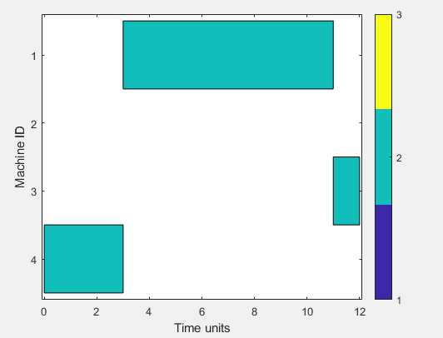
Third Step
HHprueba.step(TestingInstance)
ans(:,:,1) =
10 2 5 4
0 0 0 7
9 6 4 5
ans(:,:,2) =
1 3 3 4
0 0 0 2
1 4 2 3
Mirsh175 | Mirsh15 | Mirsh29 | Mirsh282| Mirsh95
Updated Features: 0.0514 0.3026 0.1570 0.4815 0.0417
Distance to each Rule: 0.5936 0.3845 0.7538 1.2703
LPT | SPT | MPA | LPA
Notes:
With these features, SPT should be selected again, so second job should be selected.

Slide 13
Third HH to test, random rules
Displaying information about the New HH:
Target problem: JSSP
Type: Rule-based
Training method: Undefined
Number of instances: 0 (training) | 0 (testing)
Current method:
0.8782 0.1163 0.5294 0.4995 0.1111 1.0000
0.2604 0.8190 0.9280 0.5785 0.1469 2.0000
0.6982 0.6046 0.7598 0.4474 0.0002 3.0000
0.4769 0.0649 0.5585 0.1814 0.0403 4.0000
Heuristic Ids:
1.- LPT
2.- SPT
3.- MPA
4.- LPA

Slide 14
Testing Instance
Processing Times
Machine Id’s
10 | 2 | 5 | 4
3 | 8 | 1 | 7
9 | 6 | 4 | 5
1 | 3 | 3 | 4
4 | 1 | 3 | 2
1 | 4 | 2 | 3
J1
J1
J2
J2
J3
J3
Mirsh175 | Mirsh15 | Mirsh29 | Mirsh282| Mirsh95
Initial Features: 0.0732 0.0682 0.2311 0.2963 0.0833
Distance to each rule: 0.8839 1.0808 0.9939 0.5341
LPT | SPT | MPA | LPA
Notes:
So first step should be with LPA, whic means that Job 1 should be selected.

Slide 15
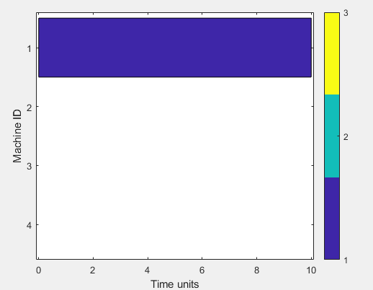
First Step
HHprueba.step(TestingInstance)
ans(:,:,1) =
0 2 5 4
3 8 1 7
9 6 4 5
ans(:,:,2) =
0 3 3 4
4 1 3 2
1 4 2 3
Mirsh175 | Mirsh15 | Mirsh29 | Mirsh282| Mirsh95
Updated Features: 0.0191 0.2106 0.0932 0.2963 0.0417
Distance to each Rule: 0.9916 1.1027 1.0419 0.6786
LPT | SPT | MPA | LPA
Notes:
With these features, LPA should be selected again, so first job should be selected.

Slide 16
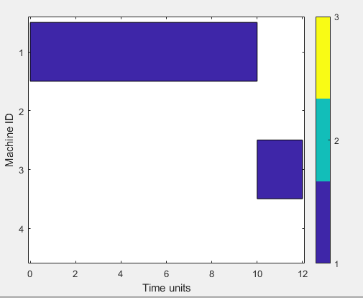
Second Step
HHprueba.step(TestingInstance)
ans(:,:,1) =
0 0 5 4
3 8 1 7
9 6 4 5
ans(:,:,2) =
0 0 3 4
4 1 3 2
1 4 2 3
Mirsh175 | Mirsh15 | Mirsh29 | Mirsh282| Mirsh95
Updated Features: 0.0180 0.2547 0.1088 0.3704 0.0417
Distance to each Rule: 0.9785 1.0501 1.0083 0.6961
LPT | SPT | MPA | LPA
Notes:
With these features, LPA should be selected again, so first job should be selected.

Slide 17
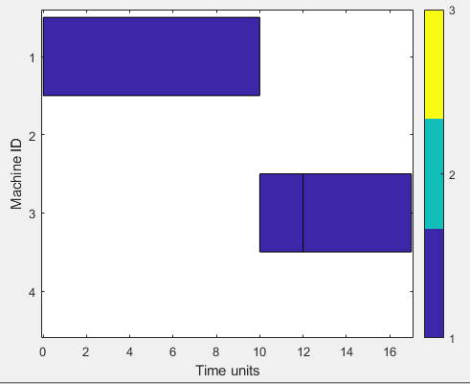
Third Step
HHprueba.step(TestingInstance)
ans(:,:,1) =
0 0 0 4
3 8 1 7
9 6 4 5
ans(:,:,2) =
0 0 0 4
4 1 3 2
1 4 2 3
Mirsh175 | Mirsh15 | Mirsh29 | Mirsh282| Mirsh95
Updated Features: 0 0.3840 0.1946 0.3704 0
Distance to each Rule: 0.9919 0.9273 0.9282 0.7064
LPT | SPT | MPA | LPA
Notes:
With these features, LPA should be selected again, so first job should be selected.

Slide 18
fourth HH to test, trained for LPTvsSPT Instances
Displaying information about the New HH:
Target problem: JSSP
Type: Rule-based
Training method: Undefined
Number of instances: 0 (training) | 0 (testing)
Current method:
0.5041 0.2179 0.4438 0.7010 0.9008 2.0000
0.9305 0.7805 0.0156 0.6456 0.3302 4.0000
0.8503 0.9509 0.9470 0.1328 0.5519 3.0000
0.1750 0.5182 0.3080 0.6764 0.0402 1.0000
0.3683 0.6202 0.8069 0.3707 0.0077 3.0000
0.9396 0.2404 0.1842 0.0001 0.4261 1.0000
0.7313 0.8783 0.5315 0.6834 0.7555 1.0000
0.1463 0.2189 0.0441 0.8986 0.6499 1.0000
0.0916 0.0571 0.5918 0.6604 0.6268 1.0000
0.5206 0.4624 0.2208 0.4964 0.1180 1.0000
SPT
LPA
MPA
LPT
MPA
LPT
LPT
LPT
LPT
LPT
Heuristic Ids:
1.- LPT
2.- SPT
3.- MPA
4.- LPA
Notes:
Let’s notice that LPT is present in 6 rules

Slide 19
LPTvsSPT Instance
Processing Times
Machine Id’s
9.9956 | 5.7059 | 3.7579 | 9.5777
5.2445 | 6.4834 | 9.9563 | 6.0503
10 | 9.9648 | 10 | 10
1 | 3 | 3 | 1
4 | 3 | 1 | 4
1 | 3 | 4 | 2
J1
J1
J2
J2
J3
J3
Mirsh175 | Mirsh15 | Mirsh29 | Mirsh282| Mirsh95
Initial Features: 0.1199 0.1346 0.2564 0.4074 0.1667
Distance to each rule: 0.9027 1.1026 1.3786 0.4911 0.7920 0.9600 1.1940 0.7264 0.6285 0.5288
SPT LPA MPA LPT MPA LPT LPT LPT LPT LPT
Notes:
So first step should be with rule 4 therefore LPT, which means that Job 3 should be selected.

Slide 20
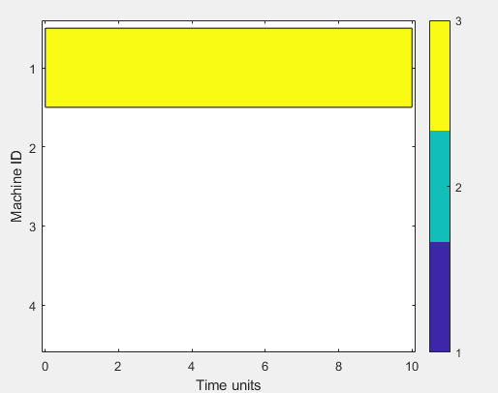
First Step
HH1.step(LPTvsSPTInstance)
ans(:,:,1) =
9.9956 5.7059 3.7579 9.5777
5.2445 4.6834 9.9563 6.0503
0 9.9648 10.0000 10.0000
ans(:,:,2) =
1 3 3 1
4 3 1 4
0 3 4 2
Mirsh175 | Mirsh15 | Mirsh29 | Mirsh282| Mirsh95
Updated Features: 0.0824 0.0431 0.1938 0.4074 0.1250
Distance to each Rule 0.9793 1.1805 1.4962 0.5717 0.8976 1.0151 1.3063 0.7578 0.6888 0.6137
SPT LPA MPA LPT MPA LPT LPT LPT LPT LPT
Notes:
Again, rule 4 is the closest one, so LPT Will be selecting Job 1

Slide 21
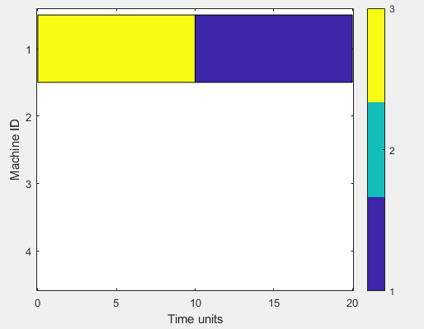
Second Step
HH1.step(LPTvsSPTInstance)
ans(:,:,1) =
0 5.7059 3.7579 9.5777
5.2445 4.6834 9.9563 6.0503
0 9.9648 10.0000 10.0000
ans(:,:,2) =
0 3 3 1
4 3 1 4
0 3 4 2
Mirsh175 | Mirsh15 | Mirsh29 | Mirsh282| Mirsh95
Updated Features 0.0849 0.1278 0.1634 0.4815 0.1250
Distance to each Rule 0.9553 1.1099 1.4769 0.4760 0.8735 1.0325 1.2470 0.6898 0.6873 0.5526
SPT LPA MPA LPT MPA LPT LPT LPT LPT LPT
Notes:
Again, rule 4 is the closest one, so LPT Will be selecting Job 3

Slide 22
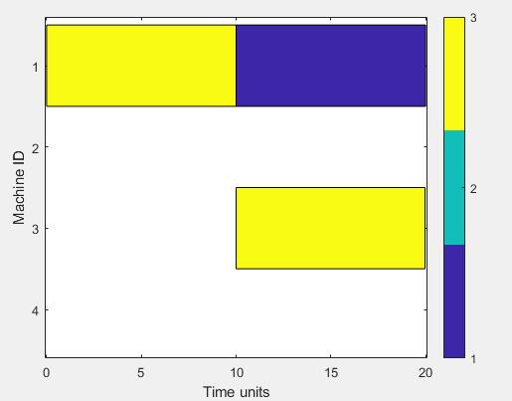
Third Step
HH1.step(LPTvsSPTInstance)
ans(:,:,1) =
0 5.7059 3.7579 9.5777
5.2445 4.6834 9.9563 6.0503
0 0 10.0000 10.0000
ans(:,:,2) =
0 3 3 1
4 3 1 4
0 0 4 2
Mirsh175 | Mirsh15 | Mirsh29 | Mirsh282| Mirsh95
Updated Features 0.0225 0.0997 0.1587 0.4815 0.0417
Distance to each Rule 1.0553 1.1911 1.5534 0.5086 0.9078 1.1141 1.3409 0.7659 0.7540 0.6242
SPT LPA MPA LPT MPA LPT LPT LPT LPT LPT
Notes:
Again, rule 4 is the closest one, so LPT Will be selecting Job 3, naturally it Will keep selecting LPT, because it was tailored to do so.

Slide 23
Testing a squared Hyper-Heuristic

Slide 24
Solvers for testing HH^2
Heuristic Ids:
1.- LPT
2.- SPT
3.- MPA
4.- LPA
Solver 1 (HH1)
Solver 2 (HH2)
Displaying information about the New HH:
Target problem: JSSP
Type: Rule-based
Training method: Undefined
Number of instances: 0 (training) | 0 (testing)
Current method:
0 0 0 0 0 1
1 1 1 1 1 2
Displaying information about the New HH:
Target problem: JSSP
Type: Rule-based
Training method: Undefined
Number of instances: 0 (training) | 0 (testing)
Current method:
0 0 0 0 0 3
1 1 1 1 1 4
LPT
SPT
MPA
LPA
Notes:
So, the first HH chooses between LPT and SPT, and the second one between MPA and LPA

Slide 25
HH2 model for testing
Displaying information about the New HH:
Target problem: JSSP
Type: Rule-based
Training method: Undefined
Number of instances: 0 (training) | 0 (testing)
Current model:
0.0000 0.0000 0.0000 0.0000 0.0000 1.0000
1.0000 1.0000 1.0000 1.0000 1.0000 2.0000
HH1
HH2
Notes:
This time the rules select HH1 or HH2

Slide 26
Testing Instance
Processing Times
Machine Id’s
10 | 2 | 5 | 4
3 | 8 | 1 | 7
9 | 6 | 4 | 5
1 | 3 | 3 | 4
4 | 1 | 3 | 2
1 | 4 | 2 | 3
J1
J1
J2
J2
J3
J3
Mirsh175 | Mirsh15 | Mirsh29 | Mirsh282| Mirsh95
Initial Features: 0.0732 0.0682 0.2311 0.2963 0.0833
Distance to each rule: 0.3977 1.9115
HH1 HH2
Notes:
So first step should be with first Solver (HH1), and from first Solver LPT should be selected, therefore, Job 1 should be scheduled.

Slide 27
First Step
sqrHH2prueba.stepInstanceHH(TestingInstance)
ans(:,:,1) =
0 2 5 4
3 8 1 7
9 6 4 5
ans(:,:,2) =
0 3 3 4
4 1 3 2
1 4 2 3
Mirsh175 | Mirsh15 | Mirsh29 | Mirsh282| Mirsh95
Updated Features: 0.0191 0.2106 0.0932 0.2963 0.0417
Distance to each Rule 0.3781 1.9548
HH1 HH2
Notes:
So, againstep should be with first Solver (HH1), and from first Solver LPT should be selected, therefore, Job 3 should be scheduled.

Slide 28
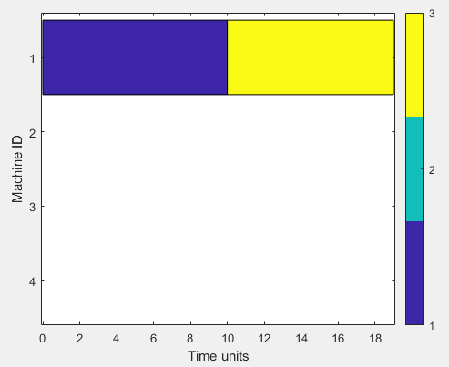
Second Step
sqrHH2prueba.stepInstanceHH(TestingInstance)
ans(:,:,1) =
0 2 5 4
3 8 1 7
0 6 4 5
ans(:,:,2) =
0 3 3 4
4 1 3 2
0 4 2 3
Mirsh175 | Mirsh15 | Mirsh29 | Mirsh282| Mirsh95
Updated Features: 0.0208 0.1541 0.1050 0.4074 0.0417
Distance to each Rule 0.4505 1.9351
HH1 HH2
Notes:
So, againstep should be with first Solver (HH1), and from first Solver LPT should be selected, therefore, Job 3 should be scheduled.

Slide 29
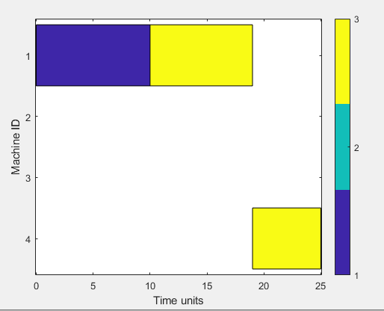
Third Step
sqrHH2prueba.stepInstanceHH(TestingInstance)
ans(:,:,1) =
0 2 5 4
3 8 1 7
0 0 4 5
ans(:,:,2) =
0 3 3 4
4 1 3 2
0 0 2 3
Mirsh175 | Mirsh15 | Mirsh29 | Mirsh282| Mirsh95
Updated Features: 0.0216 0.2353 0.1412 0.4815 0.0417
Distance to each Rule 0.5562 1.8619
HH1 HH2
Notes:
So, againstep should be with first Solver (HH1), and from first Solver LPT should be selected, therefore, Job 3 should be scheduled.

Slide 30
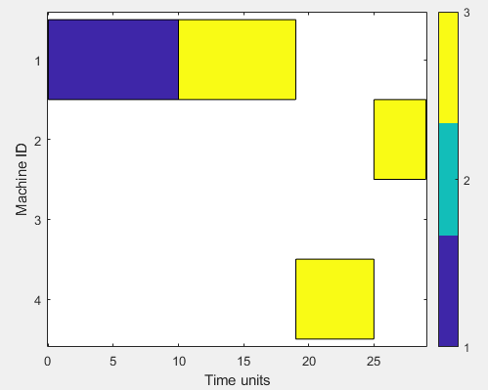
Fourth Step
sqrHH2prueba.stepInstanceHH(TestingInstance)
ans(:,:,1) =
0 2 5 4
3 8 1 7
0 0 0 5
ans(:,:,2) =
0 3 3 4
4 1 3 2
0 0 0 3
Mirsh175 | Mirsh15 | Mirsh29 | Mirsh282| Mirsh95
Updated Features: 0.0216 0.2353 0.1412 0.4815 0.0417
Distance to each Rule: 0.7081 1.7793
HH1 HH2
Notes:
So, againstep should be with first Solver (HH1), and from first Solver LPT should be selected, therefore, Job 3 should be scheduled.

Slide 31
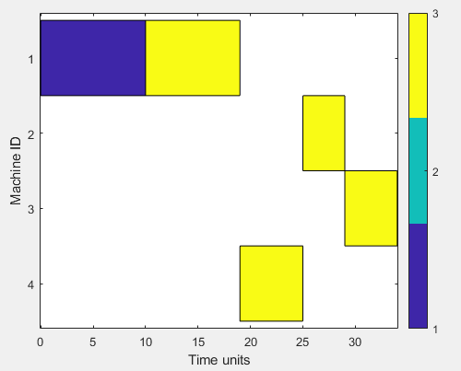
Fifth Step
sqrHH2prueba.stepInstanceHH(TestingInstance)
ans(:,:,1) =
0 2 5 4
3 8 1 7
0 0 0 0
ans(:,:,2) =
0 3 3 4
4 1 3 2
0 0 0 0
Mirsh175 | Mirsh15 | Mirsh29 | Mirsh282| Mirsh95
Updated Features: 0.0219 0.5514 0.0385 0.6667 0.0417
Distance to each Rule: 0.8673 1.7641
HH1 HH2
Notes:
So, againstep should be with first Solver (HH1), and from first Solver LPT should be selected, therefore, Job 2 should be scheduled.

Slide 32
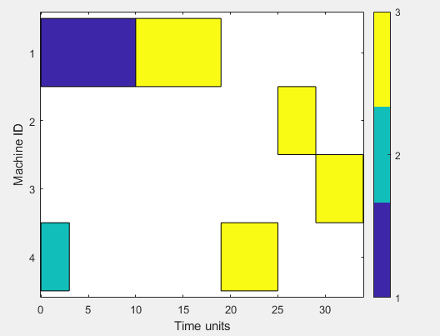
Sixth Step
sqrHH2prueba.stepInstanceHH(TestingInstance)
ans(:,:,1) =
0 2 5 4
0 8 1 7
0 0 0 0
ans(:,:,2) =
0 3 3 4
0 1 3 2
0 0 0 0
Mirsh175 | Mirsh15 | Mirsh29 | Mirsh282| Mirsh95
Updated Features 0.0208 0.5257 0.1402 0.7778 0.0417
Distance to each Rule: 0.9503 1.7002
HH1 HH2
Notes:
So, againstep should be with first Solver (HH1), and from first Solver LPT should be selected, therefore, Job 2 should be scheduled.

Slide 33
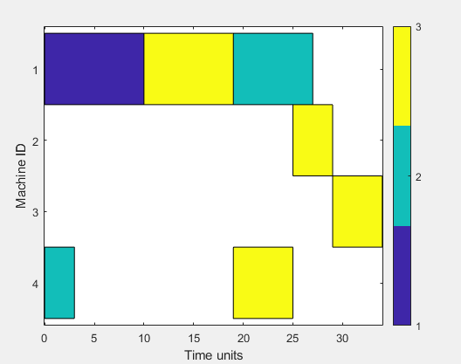
Seventh Step
sqrHH2prueba.stepInstanceHH(TestingInstance)
ans(:,:,1) =
0 2 5 4
0 0 1 7
0 0 0 0
ans(:,:,2) =
0 3 3 4
0 0 3 2
0 0 0 0
Mirsh175 | Mirsh15 | Mirsh29 | Mirsh282| Mirsh95
Updated Features 0.0247 0.5190 0.3783 0.9259 0.0417
Distance to each Rule: 1.1279 1.5789
HH1 HH2
Notes:
So, againstep should be with first Solver (HH1), and from first Solver LPT should be selected, therefore, Job 1 should be scheduled.

Slide 34
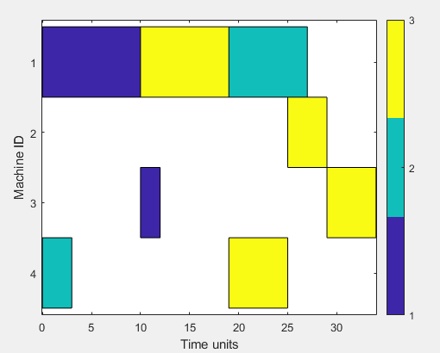
Eighth Step
sqrHH2prueba.stepInstanceHH(TestingInstance)
ans(:,:,1) =
0 0 5 4
0 0 1 7
0 0 0 0
ans(:,:,2) =
0 0 3 4
0 0 3 2
0 0 0 0
Mirsh175 | Mirsh15 | Mirsh29 | Mirsh282| Mirsh95
Updated Features: 0.0221 0.5032 0.3642 1.0370 0.0417
Distance to each Rule: 1.2098 1.5897
HH1 HH2
Notes:
So, againstep should be with first Solver (HH1), and from first Solver LPT should be selected, therefore, Job 1 should be scheduled.

Slide 35
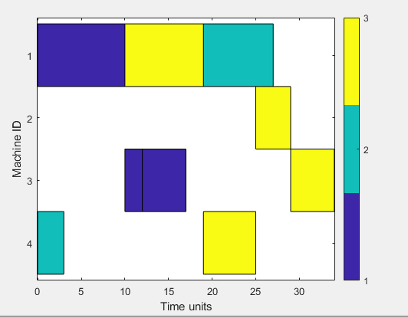
Ninth Step
sqrHH2prueba.stepInstanceHH(TestingInstance)
ans(:,:,1) =
0 0 0 4
0 0 1 7
0 0 0 0
ans(:,:,2) =
0 0 0 4
0 0 3 2
0 0 0 0
Mirsh175 | Mirsh15 | Mirsh29 | Mirsh282| Mirsh95
Updated Features: 0 0.5780 0.5270 1.0370 0
Distance to each Rule: 1.2990 1.5502
HH1 HH2
Notes:
So, againstep should be with first Solver (HH1), and from first Solver LPT should be selected, therefore, Job 1 should be scheduled…

Slide 36
Now let’s try the same model but with more complex solvers (trained HHs)
Solver 1 (HH1)
Solver 2 (HH2)
Heuristic Ids:
1.- LPT
2.- SPT
3.- MPA
4.- LPA
Displaying information about the New HH:
Target problem: JSSP
Type: Rule-based
Training method: Undefined
Number of instances: 0 (training) | 0 (testing)
Current method:
0.5041 0.2179 0.4438 0.7010 0.9008 2.0000
0.9305 0.7805 0.0156 0.6456 0.3302 4.0000
0.8503 0.9509 0.9470 0.1328 0.5519 3.0000
0.1750 0.5182 0.3080 0.6764 0.0402 1.0000
0.3683 0.6202 0.8069 0.3707 0.0077 3.0000
0.9396 0.2404 0.1842 0.0001 0.4261 1.0000
0.7313 0.8783 0.5315 0.6834 0.7555 1.0000
0.1463 0.2189 0.0441 0.8986 0.6499 1.0000
0.0916 0.0571 0.5918 0.6604 0.6268 1.0000
0.5206 0.4624 0.2208 0.4964 0.1180 1.0000
Displaying information about the New HH:
Target problem: JSSP
Type: Rule-based
Training method: Undefined
Number of instances: 0 (training) | 0 (testing)
Current method:
0.7726 0.7008 0.2220 0.3932 0.3121 3.0000
0.6454 0.9475 0.0693 0.9611 0.7562 2.0000
0.6766 0.5307 0.1813 0.3637 0.7157 1.0000
0.6402 0.0578 0.0342 0.8329 0.9774 2.0000
0.3837 0.6584 0.3485 0.8676 0.7506 3.0000
0.7656 0.2768 0.5708 0.4176 0.1703 2.0000
0.9558 0.2328 0.8960 0.4746 0.8998 2.0000
0.9542 0.6554 0.9753 0.3240 0.2452 1.0000
0.1125 0.4065 0.4937 0.5366 0.5944 2.0000
0.1123 0.7375 0.2423 0.2796 0.6157 2.0000
SPT
LPA
MPA
LPT
MPA
LPT
LPT
LPT
LPT
LPT
MPA
SPT
LPT
SPT
MPA
SPT
SPT
LPT
SPT
SPT

Slide 37
Testing Instance
Processing Times
70.3585 47.8022 8.3188 12.0060 4.7024 0.9297 24.1153 93.5362 58.7666 49.7474
97.4684 94.4108 1.7523 18.8782 46.5005 8.7490 91.6972 75.2854 5.9549 82.8802
4.4601 42.3300 9.4740 85.7191 59.8631 23.8446 23.1675 97.2087 96.0534 81.0628
97.1020 69.4727 15.8626 90.2275 41.0699 100.0000 85.0588 40.6444 97.5682 10.6402
25.1690 99.9233 63.8982 0.4276 27.3819 66.6103 46.7067 1.2941 67.3259 41.4808
78.2974 3.5925 0.7786 70.7369 92.2893 99.1745 86.9834 30.0570 1.5416 4.0763
20.5144 10.0506 80.7921 8.1309 90.5108 23.6844 21.7009 43.1301 99.0105 0.2828
62.3606 59.2837 92.3191 97.3762 6.9891 11.5035 30.8604 60.8871 13.3971 9.9004
11.7662 86.2775 95.0709 99.0838 87.2214 34.3142 5.3017 29.5900 99.6144 11.2233
90.1866 5.1947 2.4095 61.3431 5.9052 96.3029 42.7543 13.3108 80.7554 82.0192
Machine Id’s
9 8 4 5 1 8 7 1 1 10
1 9 4 1 4 10 9 4 5 3
10 10 3 8 1 3 1 6 5 8
9 10 5 10 10 9 6 6 3 4
1 10 3 8 4 5 6 7 9 2
8 7 8 4 3 4 6 2 1 5
7 2 8 3 1 3 2 6 2 4
2 10 5 6 10 8 9 7 5 8
7 6 9 1 10 1 8 5 5 2
8 10 7 4 1 6 1 6 10 1
Mirsh175 | Mirsh15 | Mirsh29 | Mirsh282| Mirsh95
Initial Features 0.2465 0.0969 0.2028 0.5630 0.6400
Distance to each rule: 0.9153 1.5295
HH1 HH2
Notes:
So first step should be with first Solver (HH1)

Slide 38
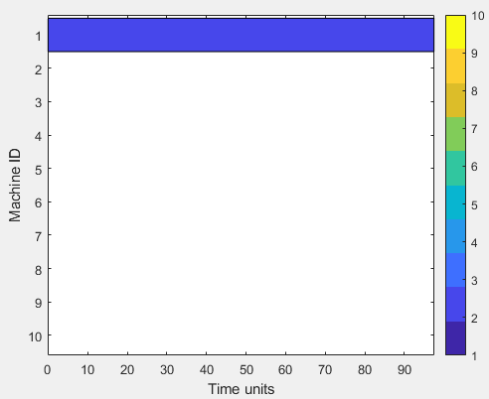
First Step
SPT LPA MPA LPT MPA LPT LPT LPT LPT LPT
HH1 Distance to each rule: 0.4756 1.0358 1.3566 0.7525 1.0442 0.9295 0.9907 0.4036 0.4319 0.6971
Solver 8 should be selected, which means that LPT must be used. So second job should be scheduled.
Mirsh175 | Mirsh15 | Mirsh29 | Mirsh282| Mirsh95
Updated Features: 0.2426 0.0998 0.1946 0.5630 0.6133
Distance to each Rule: 0.8943 1.5405
HH1 HH2
Notes:
So, again step should be with first Solver (HH1)

Slide 39
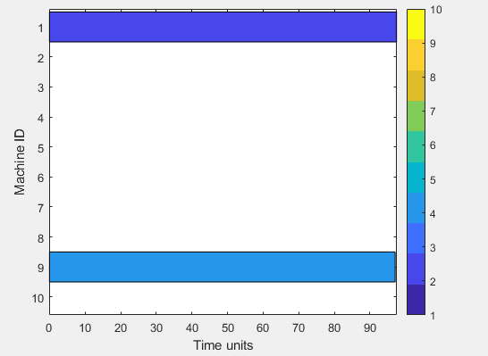
Second Step
SPT LPA MPA LPT MPA LPT LPT LPT LPT LPT
HH1 Distance to each rule: 0.4961 1.0273 1.3596 0.7306 1.0321 0.9260 0.9966 0.4001 0.4383 0.6777
Again, Solver 8 should be selected, which means that LPT must be used. So fourth job should be scheduled.
Mirsh175 | Mirsh15 | Mirsh29 | Mirsh282| Mirsh95
Updated Features: 0.2364 0.0783 0.1905 0.5630 0.5933
Distance to each Rule: 0.8759 1.5634
HH1 HH2
Notes:
So, again step should be with first Solver (HH1)

Slide 40
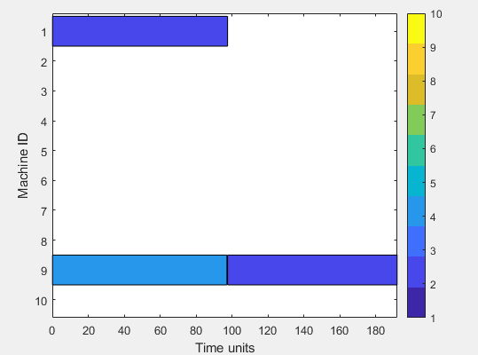
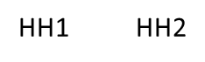
Third Step
SPT LPA MPA LPT MPA LPT LPT LPT LPT LPT
HH1 Distance to each rule: 0.5186 1.0399 1.3774 0.7280 1.0349 0.9304 1.0208 0.4064 0.4394 0.6780
Again, Solver 8 should be selected, which means that LPT must be used. So job 2 should be scheduled.
Mirsh175 | Mirsh15 | Mirsh29 | Mirsh282| Mirsh95
Updated Features: 0.2388 0.0957 0.1918 0.5926 0.5933
Distance to each Rule: 0.8979 1.5433
Notes:
So, again step should be with first Solver (HH1)

Slide 41
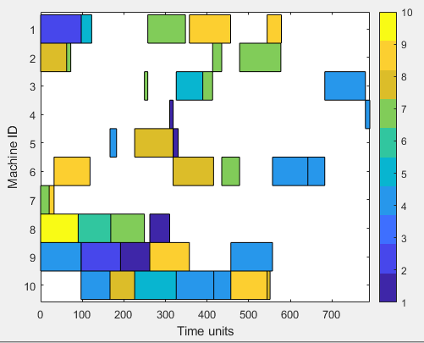
The exactly same result continued up to step 42 where the first solver was selected again (HH1) but now the solver number 4 of the first solver was now selected, which happened to be LPT again.
Mirsh175 | Mirsh15 | Mirsh29 | Mirsh282| Mirsh95
Updated Features: 0.1047 0.4193 0.2347 1.2622 0.2200
Distance to each Rule: 1.3724 1.5497
Notes:
Here I stopped the Testing for this model.

Slide 42
Now we trained a HH^2 with two already trained HHs, the model:
Displaying information about the New HH:
Target problem: JSSP
Type: Rule-based
Training method: Undefined
Number of instances: 0 (training) | 0 (testing)
Current model:
0.0583 0.8572 0.4881 0.2421 0.4229 1.0000
0.2082 0.2742 0.5886 0.2156 0.7970 2.0000
HH^2 Solvers:
HH1 (LPTvsSPT trained)
2. HH2 (SPTvsLPT trained)

Slide 43
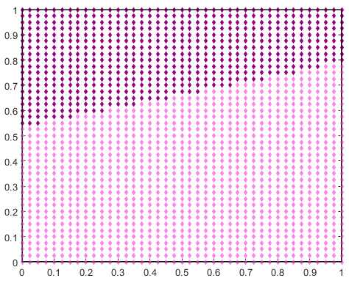
Trained hh^2 (5 features, 2 rules) solvers: hh1, hh2
HH^2 Solvers:
HH1 (LPTvsSPT trained)
2. HH2 (SPTvsLPT trained)
Notes:
Se entreno sobre un set de 30 instancias random J3xM4 (preliminary instances)

Slide 44
The HHs are the same as previous case:
Heuristic Ids:
1.- LPT
2.- SPT
3.- MPA
4.- LPA
Solver 1 (HH1)
Trained for LPTvsSPT Instances
Solver 2 (HH2)
Trained for SPTvsLPT Instances
Displaying information about the New HH:
Target problem: JSSP
Type: Rule-based
Training method: Undefined
Number of instances: 0 (training) | 0 (testing)
Current method:
0.5041 0.2179 0.4438 0.7010 0.9008 2.0000
0.9305 0.7805 0.0156 0.6456 0.3302 4.0000
0.8503 0.9509 0.9470 0.1328 0.5519 3.0000
0.1750 0.5182 0.3080 0.6764 0.0402 1.0000
0.3683 0.6202 0.8069 0.3707 0.0077 3.0000
0.9396 0.2404 0.1842 0.0001 0.4261 1.0000
0.7313 0.8783 0.5315 0.6834 0.7555 1.0000
0.1463 0.2189 0.0441 0.8986 0.6499 1.0000
0.0916 0.0571 0.5918 0.6604 0.6268 1.0000
0.5206 0.4624 0.2208 0.4964 0.1180 1.0000
Displaying information about the New HH:
Target problem: JSSP
Type: Rule-based
Training method: Undefined
Number of instances: 0 (training) | 0 (testing)
Current method:
0.7726 0.7008 0.2220 0.3932 0.3121 3.0000
0.6454 0.9475 0.0693 0.9611 0.7562 2.0000
0.6766 0.5307 0.1813 0.3637 0.7157 1.0000
0.6402 0.0578 0.0342 0.8329 0.9774 2.0000
0.3837 0.6584 0.3485 0.8676 0.7506 3.0000
0.7656 0.2768 0.5708 0.4176 0.1703 2.0000
0.9558 0.2328 0.8960 0.4746 0.8998 2.0000
0.9542 0.6554 0.9753 0.3240 0.2452 1.0000
0.1125 0.4065 0.4937 0.5366 0.5944 2.0000
0.1123 0.7375 0.2423 0.2796 0.6157 2.0000
SPT
LPA
MPA
LPT
MPA
LPT
LPT
LPT
LPT
LPT
MPA
SPT
LPT
SPT
MPA
SPT
SPT
LPT
SPT
SPT

Slide 45
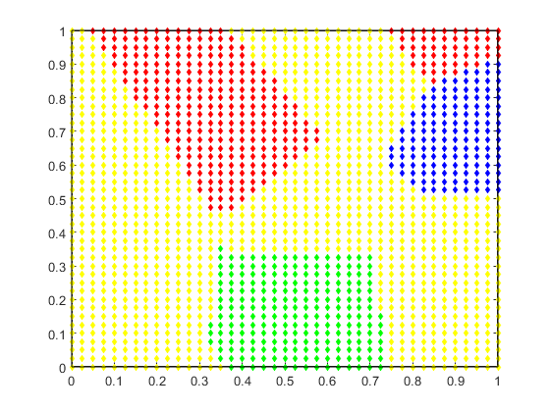
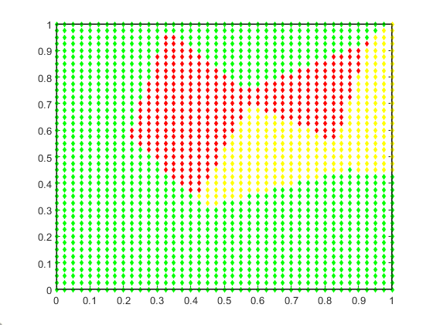
TRAINED HHs (5 features, 10 rules) solvers: lpt, spt mpa, lpa
Solver 1 (HH1)
Solver 2 (HH2)
Heuristic Ids:
1.- LPT
2.- SPT
3.- MPA
4.- LPA
These plots of the influence zones are only a slice view of features 1 and 2
Notes:
HH1 was trained with a set of instances LPTvsSPT (preliminary instances) (J3xM4), HH2 the opposite

Slide 46
Set of 30 instances LPTvsSPT
Set of 30 instances SPTvsLPT
trained with
trained with
Set of 30 random instances
HH1
HH2
Solvers
trained with
Solvers
LPT
SPT
MPA
LPA
solver of
solver of
LPT
SPT
MPA
LPA
HH^2

Slide 47
Let’s see how it behaves with a random instance
Processing Times
Machine Id’s
2.6532 | 3.7356 | 1.8062 | 3.4744
9.2458 | 0.8750 | 0.4505 | 6.6062
2.2377 | 6.4012 | 7.2317 | 3.8387
3 | 4 | 2 | 3
1 | 3 | 3 | 2
4 | 4 | 3 | 1
J1
J1
J2
J2
J3
J3
Mirsh222 | Mirsh15 | Mirsh29 | Mirsh282| Mirsh95
Initial Features: 0.0688 0.1468 0.1098 0.3333 0.0833
Distance to each rule: 0.8783 0.8877
Notes:
So first step should be with first Solver (HH1)

Slide 48
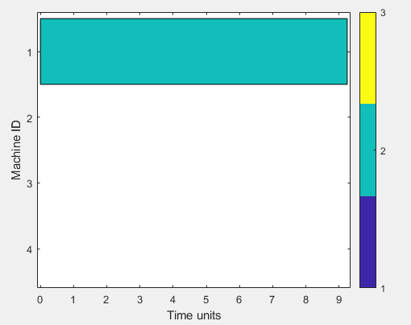
First Step
SPT LPA MPA LPT MPA LPT LPT LPT LPT LPT
HH1 Distance to each rule: 1.0534 1.1451 1.4892 0.5550 0.8982 1.0006 1.3139 0.8100 0.8020 0.5864
Solver 4 should be selected, which means that LPT must be used. So second job should be scheduled.
ans(:,:,1) =
2.6532 3.7356 1.8062 3.4744
0 0.8750 0.4505 6.6062
2.2377 6.4012 7.2317 3.8387
ans(:,:,2) =
3 4 2 3
0 3 3 2
4 4 3 1
Mirsh175 | Mirsh15 | Mirsh29 | Mirsh282| Mirsh95
Updated Features: 0.0779 0.2655 0.2421 0.4444 0.0833
Distance to each Rule: 0.7532 0.8359
Notes:
So, again step should be with first Solver (HH1)

Slide 49
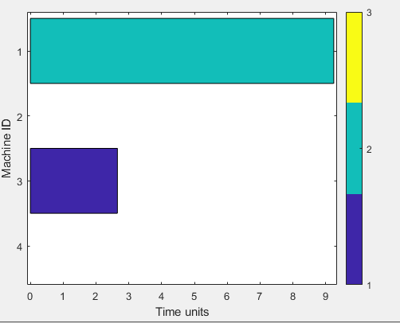
Second Step
SPT LPA MPA LPT MPA LPT LPT LPT LPT LPT
HH1 Distance to each rule: 0.9791 1.0700 1.3710 0.3651 0.7350 1.0303 1.1812 0.7572 0.7127 0.4890
Again, Solver 4 should be selected, which means that LPT must be used. So first job should be scheduled.
ans(:,:,1) =
0 3.7356 1.8062 3.4744
0 0.8750 0.4505 6.6062
2.2377 6.4012 7.2317 3.8387
ans(:,:,2) =
0 4 2 3
0 3 3 2
4 4 3 1
Mirsh175 | Mirsh15 | Mirsh29 | Mirsh282| Mirsh95
Updated Features: 0.0760 0.3079 0.2170 0.4815 0.0833
Distance to each Rule: 0.7403 0.8583
Notes:
So, again step should be with first Solver (HH1)

Slide 50
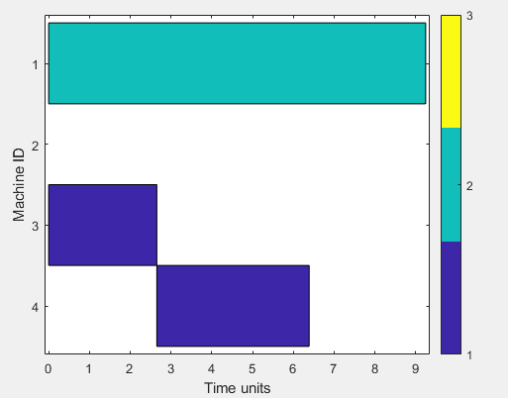
Third Step
SPT LPA MPA LPT MPA LPT LPT LPT LPT LPT
HH1 Distance to each rule: 0.9795 1.0402 1.3736 0.3196 0.7409 1.0492 1.1603 0.7333 0.7287 0.4722
Again, Solver 4 should be selected, which means that LPT must be used. So first job should be scheduled.
ans(:,:,1) =
0 0 1.8062 3.4744
0 0.8750 0.4505 6.6062
2.2377 6.4012 7.2317 3.8387
ans(:,:,2) =
0 0 2 3
0 3 3 2
4 4 3 1
Mirsh175 | Mirsh15 | Mirsh29 | Mirsh282| Mirsh95
Updated Features: 0.0328 0.4046 0.2043 0.4815 0.0417
Distance to each Rule: 0.6991 0.9147
Notes:
So, again step should be with first Solver (HH1)

Slide 51
The rest of the instance had the same result, HH1 was always selected, and from HH1 solver 4 was always selected, meaning that all steps were executed with LPT.
Final makespan was: 27.0784
Which is the same result as if HH1 was used alone, or if LPT was used alone.
Solution with second solver (HH2) is also, 27.0784 but the heuristics used were SPT from step 1:8 and MPA for the rest of the steps.
Notes:
In the next slide there are the final plots of the instance with both solvers.

Slide 52
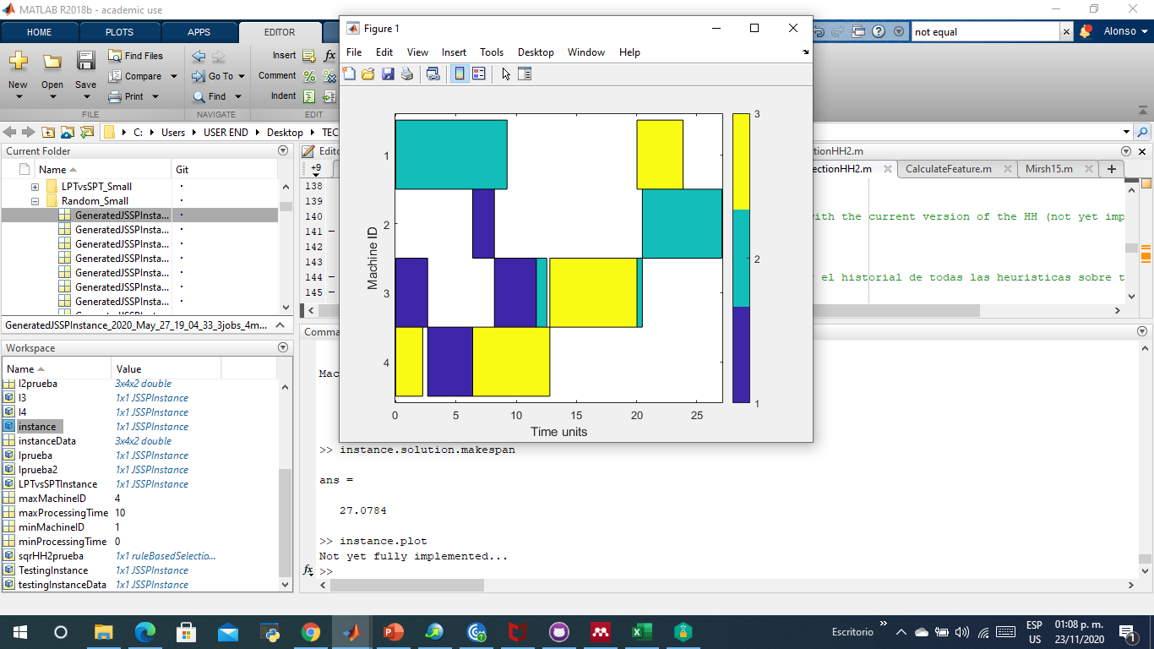
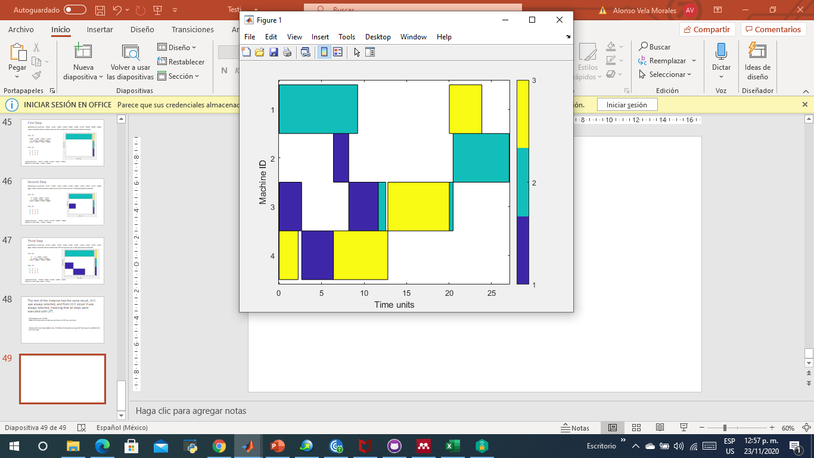
Plot with HH^2 or HH1 or LPT
Order of Heuristics: LPTx12
Plot with HH2
Order of Heuristics: SPTx8 MPAx4
Final makespan: 27.0784
So this tells us that there are instances in which there are no difference between the solvers Applied, although…
Notes:
Fact: this is not the optimal Schedule for this instance (visually), but maybe any combination of the 4 heuristics we are using is able to give it.

Slide 53
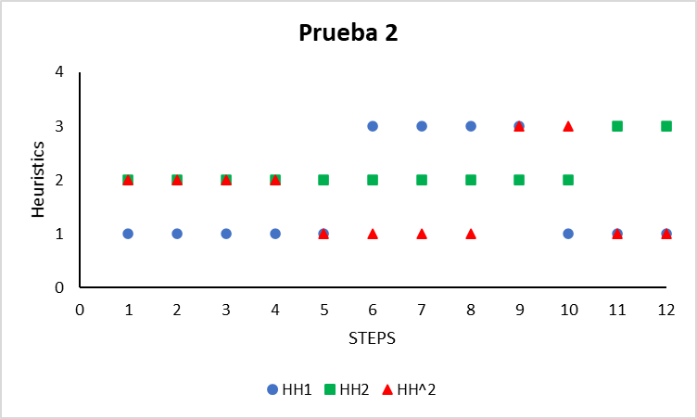
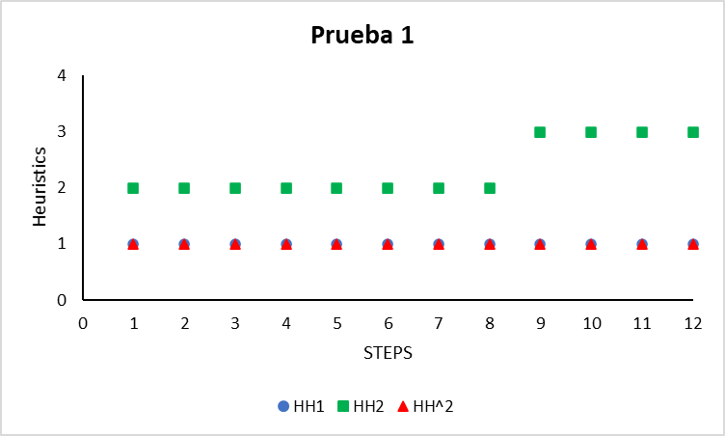
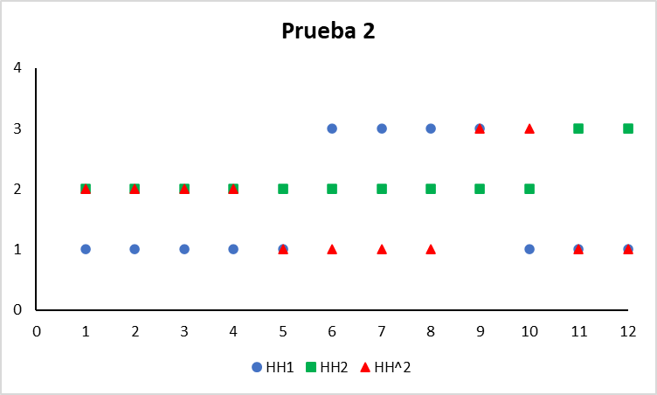
LPA
MPA
SPT
LPT
Final makespan: 27.0784

Slide 54
Let’s try a different random Instance, same HH^2 model…
Processing Times
Machine Id’s
4.5164 | 9.8610 | 0.8708 | 0.6695
2.2771 | 0.2999 | 8.0209 | 9.3940
8.0445 | 5.3566 | 9.8914 | 0.1818
3 | 4 | 1 | 1
4 | 4 | 1 | 1
3 | 3 | 1 | 3
J1
J1
J2
J2
J3
J3
Mirsh175 | Mirsh15 | Mirsh29 | Mirsh282| Mirsh95
Initial Features: 0.2324 0.1104 0.4045 0.6296 0.2500
Distance to each rule: 0.8803 0.7293
Notes:
So first step should be with second Solver (HH2)

Slide 55
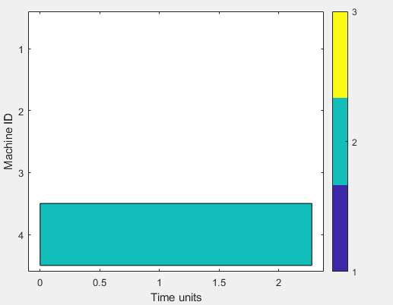
First Step
MPA SPT LPT SPT MPA SPT SPT LPT SPT SPT
HH2 Distance to each rule: 0.8564 1.1618 0.8434 0.9363 0.7959 0.6253 1.1074 1.1123 0.4871 0.8308
From HH2 solver 9 is selected, which means that first step is applied with SPT, so Job 2 should be scheduled.
ans(:,:,1) =
4.5164 9.8610 0.8708 0.6695
0 0.2999 8.0209 9.3940
8.0445 5.3566 9.8914 0.1818
ans(:,:,2) =
3 4 1 1
0 4 1 1
3 3 1 3
Mirsh175 | Mirsh15 | Mirsh29 | Mirsh282| Mirsh95
Updated Features: 0.2215 0.1199 0.4278 0.7407 0.2500
Distance to each Rule: 0.9233 0.7905
Notes:
So, again step should be with second Solver (HH2)

Slide 56

Second Step
MPA SPT LPT SPT MPA SPT SPT LPT SPT SPT
HH2 Distance to each rule: 0.8990 1.1393 0.8920 0.9337 0.7676 0.6723 1.1244 1.1389 0.5086 0.8799
Again, From HH2 solver 9 is selected, which means that second step is applied with SPT, so Job 2 should be scheduled.
ans(:,:,1) =
4.5164 9.8610 0.8708 0.6695
0 0 8.0209 9.3940
8.0445 5.3566 9.8914 0.1818
ans(:,:,2) =
3 4 1 1
0 0 1 1
3 3 1 3
Mirsh175 | Mirsh15 | Mirsh29 | Mirsh282| Mirsh95
Updated Features: 0.1745 0.1221 0.4313 0.7407 0.2083
Distance to each Rule: 0.9229 0.8193
Notes:
So, again step should be with second Solver (HH2)

Slide 57
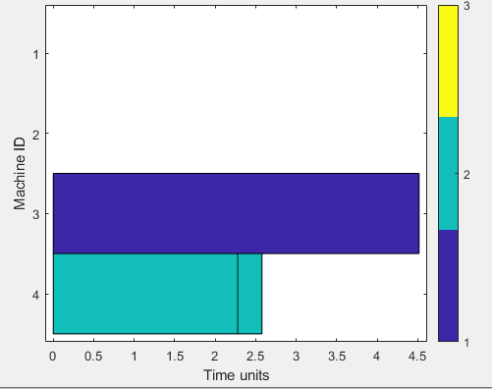
Third Step
MPA SPT LPT SPT MPA SPT SPT LPT SPT SPT
HH2 Distance to each rule: 0.9316 1.1759 0.9387 0.9893 0.8052 0.7062 1.1780 1.1676 0.5285 0.8927
Again, From HH2 solver 9 is selected, which means that third step is applied with SPT, so Job 1 should be scheduled.
ans(:,:,1) =
0 9.8610 0.8708 0.6695
0 0 8.0209 9.3940
8.0445 5.3566 9.8914 0.1818
ans(:,:,2) =
0 4 1 1
0 0 1 1
3 3 1 3
Mirsh175 | Mirsh15 | Mirsh29 | Mirsh282| Mirsh95
Updated Features: 0.1368 0.2002 0.4581 0.7407 0.1667
Distance to each Rule: 0.8678 0.8371
Notes:
So, again step should be with second Solver (HH2)

Slide 58
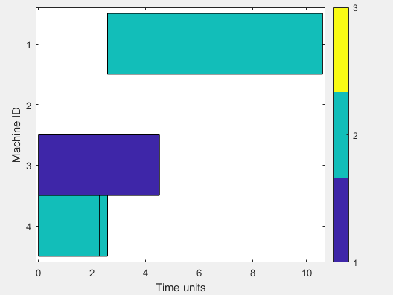
Fourth Step
MPA SPT LPT SPT MPA SPT SPT LPT SPT SPT
HH2 Distance to each rule: 0.9233 1.1681 0.9596 1.0579 0.8000 0.7200 1.2133 1.1501 0.5187 0.8661
Again, From HH2 solver 9 is selected, which means that fourth step is applied with SPT, so Job 2 should be scheduled.
ans(:,:,1) =
0 9.8610 0.8708 0.6695
0 0 0 9.3940
8.0445 5.3566 9.8914 0.1818
ans(:,:,2) =
0 4 1 1
0 0 0 1
3 3 1 3
Mirsh175 | Mirsh15 | Mirsh29 | Mirsh282| Mirsh95
Updated Features: 0.0588 0.2983 0.3917 0.7407 0.0833
Distance to each Rule: 0.8280 0.9202 (for the first time the HH^2 Selected a different solver)
Notes:
For the first time HH1 was selected!!

Slide 59
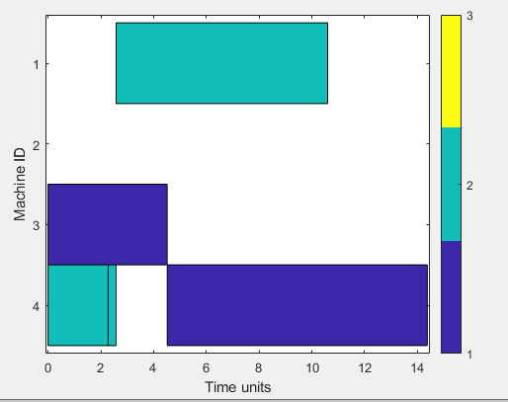
Fifth Step
Now the fifth step will be in hands of HH1!
Distance to each rule: 0.9367 1.0971 1.3963 0.2735 0.7173 1.2200 1.1240 0.6933 0.6334 0.5747
From HH1, solver 4 is selected, which means that fifth step is applied with LPT, so Job 1 should be scheduled.
SPT LPA MPA LPT MPA LPT LPT LPT LPT LPT
ans(:,:,1) =
0 0 0.8708 0.6695
0 0 0 9.3940
8.0445 5.3566 9.8914 0.1818
ans(:,:,2) =
0 0 1 1
0 0 0 1
3 3 1 3
Mirsh175 | Mirsh15 | Mirsh29 | Mirsh282| Mirsh95
Updated Features: 0.0662 0.5601 0.6024 0.8889 0.0833
Distance to each Rule: 0.7969 1.0318
Notes:
Again HH1 is selected

Slide 60
SUMMARY OF LAST TEST
In this Testing, we achieved that the trained HH^2 change from one solver to another. So let’s see the final makespan with the three solvers (HH^2, HH1, HH2)
Solving the instance with only HH1 we get a makespan of 38.7128 and a heuristic distribution of: [LPTx5 MPAx4 LPTx3]
Solving the instance with only HH2 we get a makespan of 31.6054 and a heuristic distribution of: [SPTx10 MPAx2]
Solving the instance with the HH^2 we get a makespan of 31.4236 and a solver distribution of: [HH2x4 HH1x8] and a heuristic distribution of: [SPTx4 LPTx4 MPAx2 LPTx2]
Which means that for at least this instance, HH^2 performs better than its individual solvers.
Notes:
PLOTS in the next slide

Slide 61
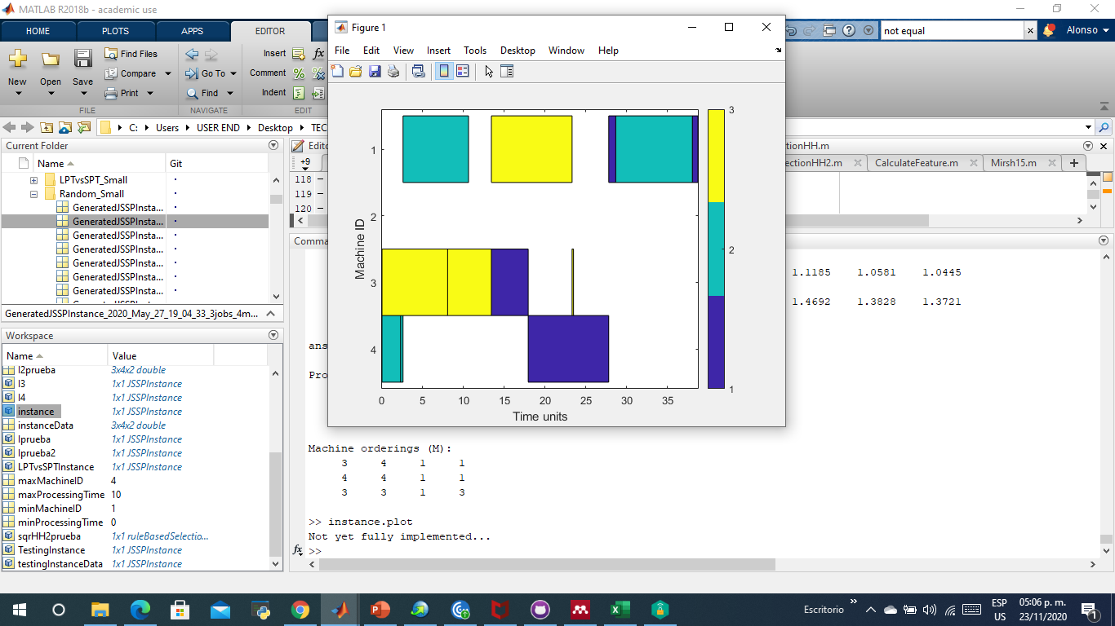
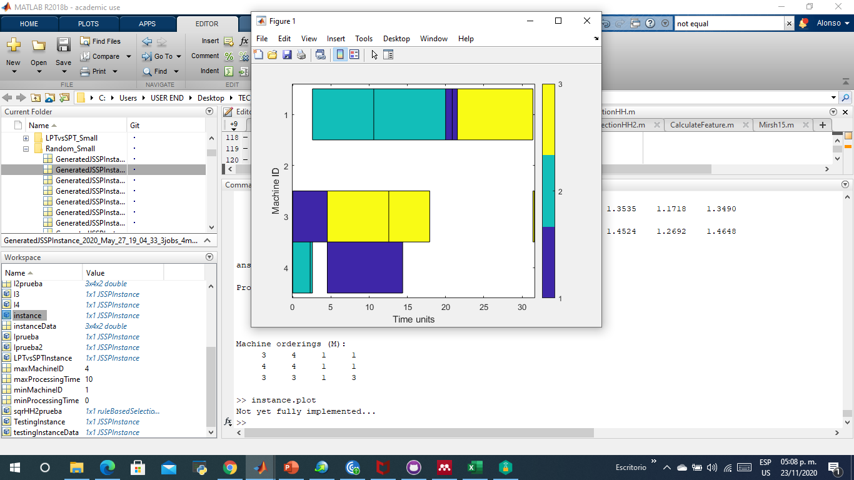

PLOTS of previous results
Plot with HH^2
Order of Solvers: [HH2X4 HH1X8]
Order of Heuristics: [SPTx4 LPTx4 MPAx2 LPTx2]
Plot with HH1
Order of Heuristics: [LPTx5 MPAx4 LPTx3]
Plot with HH2
Order of Heuristics: [SPTx10 MPAx2]
Makespan: 38.7128
Makespan: 31.6054
Makespan: 31.4236

Slide 62
LPA
MPA
SPT
LPT
Makespan: 38.7128
Makespan: 31.6054
Makespan: 31.4236

Slide 63
Lastly, let’s try an instance tailored as LPTvsSPT (LPT is favored)
Processing Times
Machine Id’s
9.9956 | 5.7059 | 3.7579 | 9.5777
5.2445 | 4.6834 | 9.9563 | 6.0503
10 | 9.9648 | 10 | 10
1 | 3 | 3 | 1
4 | 3 | 1 | 4
1 | 3 | 4 | 2
J1
J1
J2
J2
J3
J3
Notes:
Now let’s test our HH^2 model, the HH’s and the individual heuristics

Slide 64
Now let’s see what are the Results of individual heuristics:
Makespan with LPT: 39.9648
Makespan with SPT: 88.8860
As expected, makespan with LPT is smaller…
Now, our trained HH’s, let’s remember that HH1 was trained with LPTvsSPT instances and HH2 trained with SPTvsLPT instances.
Makespan with HH1 is also 39.9648, it chosed always LPT.
Makespan with HH2 is also 88.8860, it chosed SPTx8 MPAx4
This was also expected but let’s say that is a relief that our training method for HH’s works.
Makespan with HH^2 is 39.9648, it chosed HH2x2 and HH1x10, and the heurisic distribution was [SPTx2 LPTx10]. So it was able to select the best HH.

Slide 65
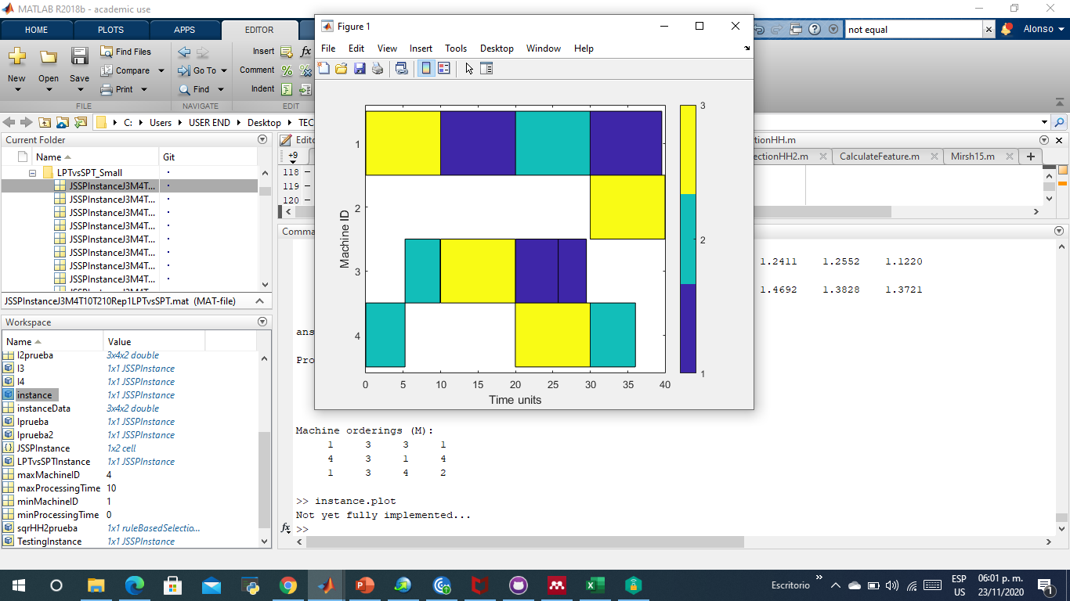
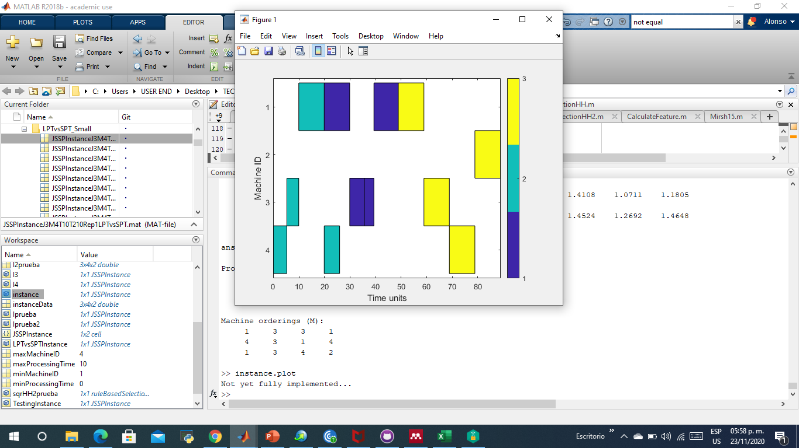

PLOTS of different methods for instance LPTvsSPT
Plot with HH1
Order of Heuristics: [LPTx12]
Plot with HH2
Order of Heuristics: [SPTx8 MPAx4]
Plot with HH^2
Order of Solvers: [HH2X2 HH1X10]
Order of Heuristics: [SPTx2 LPTx10]
Makespan: 39.9648
Makespan: 88.8860
Makespan: 39.9648
Notes:
HH2 plot is equal to the plot of solving the instance with only SPT, and HH1 and HH^2 plots is equal as solving the instance with only LPT.

Slide 66
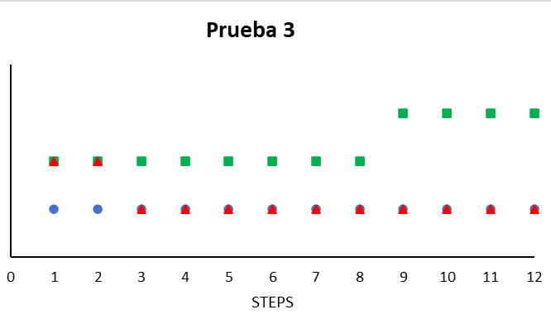
LPA
MPA
SPT
LPT
Makespan: 39.9648
Makespan: 88.8860
Makespan: 39.9648

Slide 67
Lastly, let’s try an instance tailored as SPTvsLPT (SPT is favored)
Processing Times
Machine Id’s
0.0198 | 9.9347 | 10 | 10
10 | 0.4823 | 10 | 8.9412
0 | 0 | 10 | 10
4 | 4 | 1 | 3
4 | 4 | 4 | 4
1 | 4 | 3 | 1
J1
J1
J2
J2
J3
J3
Notes:
Now let’s test our HH^2 model, the HH’s and the individual heuristics

Slide 68
Now let’s see what are the Results of individual heuristics:
Makespan with LPT: 79.3781
Makespan with SPT: 39.3781
As expected, makespan with SPT is smaller…
Now, our trained HH’s, let’s remember that HH1 was trained with LPTvsSPT instances and HH2 trained with SPTvsLPT instances.
Makespan with HH1 is also 79.3781, it chosed always LPT.
Makespan with HH2 is also 39.3781 , it chosed SPTx10 MPAx2
This was also expected but let’s say that is a relief that our training method for HH’s works.
Makespan with HH^2 is 39.3781, it chosed HH2x4 and HH1x8, and the heurisic distribution was [SPTx4 LPTx5 MPA LPTX2].
Notes:
Although it did not always choose SPT, HH^2 was able to get the same makespan as SPT and HH2.

Slide 69
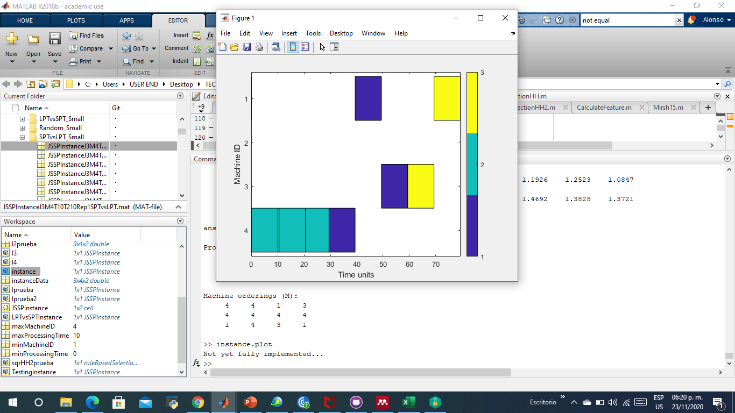
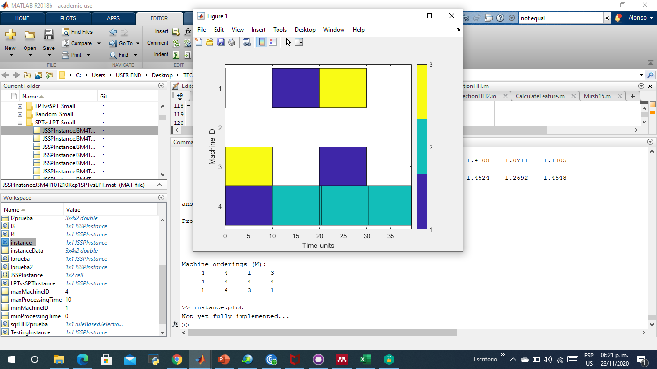

PLOTS of different methods for instance SPTvsLPT
Plot with HH1
Order of Heuristics: [LPTx12]
Plot with HH2
Order of Heuristics: [SPTx10 MPAx2]
Plot with HH^2
Order of Solvers: [HH2X4 HH1X8]
Order of Heuristics: [SPTx4 LPTx5 MPA LPTX2]
Makespan: 79.3781
Makespan: 39.3781
Makespan: 39.3781
Notes:
HH1 plot is equal to the plot of solving the instance with only LPT, and HH2 and HH^2 plots is equal as solving the instance with only SPT.

Slide 70
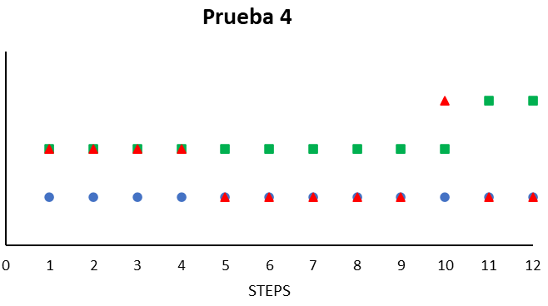
LPA
MPA
SPT
LPT
Makespan: 79.3781
Makespan: 39.3781
Makespan: 39.3781

Slide 71
SUMMARY
Two instances were tested, one tailored as LPTvsSPT, and the other tailored as SPTvsLPT.
In both scenarios, and as expected, the heuristics for what the instance was tailored succeed in achieving, by far, the best makespan. The same happened with HH1 and HH2.
And viceversa, LPT, SPT, HH1 and HH2 failed at getting the best makespan on the instance where they were supposed to failed.
Suprinsignly, HH^2 was able to get the best makespan in both cases. This tells us that, at least for these instances, we can have specific HH’s within a higher level method, in this case a HH^2, and select them (the HH’s) whenever they are required according to the problem features.
Further Testing is required, Testing sets of instances instead of individual ones to measure the impact of this model.
Notes:
The instances used for this Testing were the first one to appear in their respective sets. That is, I did not look for an specific Instance to match this conditions.

Slide 72

Translation Algorithm: ${HH}^{2}→HH$
HH1
HH2
H1
H2
H3
H4
H1
H4
0
1
0
1
0
1
0
1
Notes:
It looks that solver 2 and 3 dissapear, unless F1=0.5 and randomly goes to H2 and H4, for simplicity let’s say that only one random direction is applied. But let see if we can overcome this later.

Slide 73
What about translating this HH^2 model, it is not that intuitive at first sight…
Notes:
What about translating this model?

Slide 74
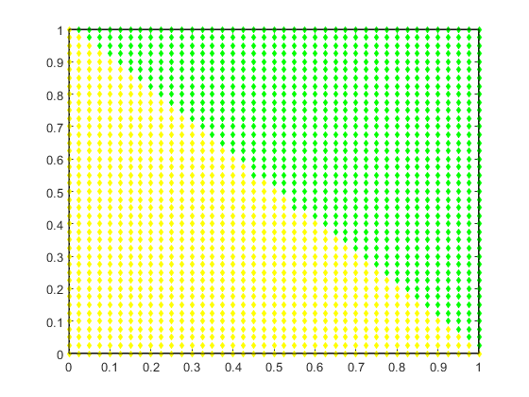
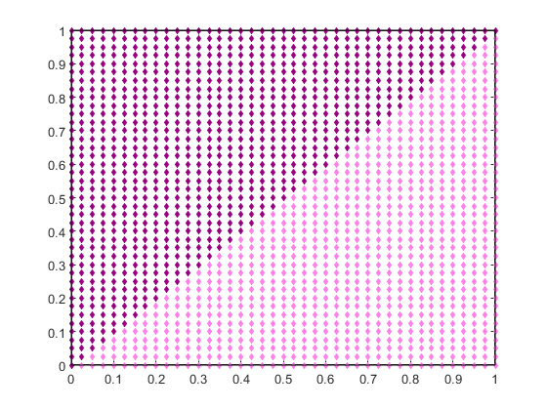

HH1
HH^2
H2
H1
HH1
HH2
HH2
H4
H3
With these plots is easy to imagine how it is the translated plot for the reduced HH, but how about its model?
Notes:
What about translating this model?

Slide 75
1. Segmentation
What is the feature value range in which a rule gets picked…
Notes:
Between what numbers that specific solver Will be selected?

Slide 76
II. Scaling
Reconcile the ranges of the individual solvers according to the ranges of the HH^2…
Notes:
Let’s fit the HHs ranges to the HH^2 ranges

Slide 77
III. Segment Reconciliation
Apply inverse process to find the number that generate those ranges…
Notes:
Inverse process, if we have these ranges, from what feature value can they be?, este paso puede ser difícil para mas de dos reglas

Slide 78
Translation Completed
Each rule from the individual solvers becomes a rule for the translated HH model

Slide 79
Notes:
We can manually check if it Works. Con los modelos iniciales no es tan fácil intuir el modelo final.

Slide 80

HH1
TRANSLATED HH
H2
H1
H2
HH2
H4
H1
H4
H3
HH^2
H3
HH1
HH2
Notes:
Ahora, ingresando los valores de los modelos al código, veamos si corresponde con los mapas.

Slide 81

























I. Segmentation
$$C_{1,1}$$
$$C_{1,2}$$
$$0:y_{1,1}$$
$$0:y_{1,2}$$
$$C_{2,1}$$
$$C_{2,2}$$
$$y_{1,1}:y_{2,1}$$
$$y_{1,2}:y_{2,2}$$
$$C_{3,1}$$
$$C_{3,2}$$
$$y_{2,1}:y_{3,1}$$
$$y_{2,2}:y_{3,2}$$
$$…$$
$$…$$
$$…$$
$$…$$
$$…$$
$$…$$
$$…$$
$$…$$
$$C_{n,1}$$
$$C_{n,2}$$
$$y_{n−1,1}:1$$
$$y_{n−1,2}:1$$
$\left(C_{1,x},C_{2,x},C_{3,x} …C_{n,x}\right) →(0:\frac{C_{1,x}+C_{2,x}}{2}$, $\frac{C_{1,x}+C_{2x}}{2}$: $\frac{C_{2,x}+C_{3,x}}{2}$… $\frac{C_{n−1,x}+C_{n,x}}{2}$: $1$)
$$increasing order$$
$$→(0:y_{1,x},y_{1,x}:y_{2,x} …y_{n−1,x}:1)$$
Notes:
We have to re arrange the rules from smaller to larger

Slide 82










II. Scaling
$$y_{1,1}:y_{2,1}$$
$$y_{1,2}:y_{2,2}$$
$$z_{1,1}:z_{2,1}$$
$$z_{1,2}:z_{2,2}$$
$$z_{2,1}:z_{3,1}$$
$$z_{2,2}:z_{3,2}$$
$$z_{1,1}^{∗}:z_{2,1}^{∗}$$
$$z_{1,2}^{∗}:z_{2,2}^{∗}$$
$$z_{2,1}^{∗}:z_{3,1}^{∗}$$
$$z_{2,2}^{∗}:z_{3,2}^{∗}$$
($y_{1,x} :y_{2,x}),(z_{1,x} :z_{2,x},z_{2,x}:z_{3,x})→({((y}_{2,x}−y_{1,x})∗z_{1,x}+y_{1,x}):{((y}_{2,x}−y_{1,x})∗z_{2,x}+y_{1,x}),({(y}_{2,x}−y_{1,x})∗z_{2,x}+y_{1,x}):{((y}_{2,x}−y_{1,x})∗z_{3,x}+y_{1,x})→(z_{1,x}^{∗}:z_{2,x}^{∗},z_{2,x}^{∗}:z_{3,x}^{∗})$

Slide 83








III. Segment reconciliation
$$z_{1,1}^{∗}:z_{2,1}^{∗}$$
$$z_{1,2}^{∗}:z_{2,2}^{∗}$$
$$C_{1,1}$$
$$C_{1,2}$$
$$z_{2,1}^{∗}:z_{3,1}^{∗}$$
$$z_{2,2}^{∗}:z_{3,2}^{∗}$$
$$C_{2,1}$$
$$C_{2,2}$$
$$\left(z_{1,x}^{∗}:z_{2,x}^{∗},z_{2,x}^{∗}:z_{3,x}^{∗} …z_{n−1,x}^{∗}:z_{n,x}^{∗}\right)→C_{1,x}=\left(2∗z_{2,x}^{∗}−C_{2,x}\right), { C}_{2,x}=\left(2∗z_{3,x}^{∗}−C_{3,x}\right)…C_{m−1,x}=\left(2∗z_{n−1,x}^{∗}−C_{m,x}\right)→Numerical Method$$

Slide 84


Translation Algorithm: ${HH}^{2}→HH$
Segmentation: $\left(x_{1},x_{2},x_{3} …x_{n}\right) →(0:\frac{x_{1}+x_{2}}{2}$, $\frac{x_{1}+x_{2}}{2}$: $\frac{x_{2}+x_{3}}{2}$… $\frac{x_{n−1}+x_{n}}{2}$: $1$)
Scaling: ($y_{1,x} :y_{2,x}),(z_{1,x} :z_{2,x},z_{2,x}:z_{3,x})→({((y}_{2,x}−y_{1,x})∗z_{1,x}+y_{1,x}):{((y}_{2,x}−y_{1,x})∗z_{2,x}+y_{1,x}),({(y}_{2,x}−y_{1,x})∗z_{2,x}+y_{1,x}):{((y}_{2,x}−y_{1,x})∗z_{3,x}+y_{1,x})→(z_{1,x}^{∗}:z_{2,x}^{∗},z_{2,x}^{∗}:z_{3,x}^{∗})$
Segment Reconciliation:$\left(z_{1,x}^{∗}:z_{2,x}^{∗},z_{2,x}^{∗}:z_{3,x}^{∗} …z_{n−1,x}^{∗}:z_{n,x}^{∗}\right)→C_{1,x}=\left(2∗z_{2,x}^{∗}−C_{2,x}\right), { C}_{2,x}=\left(2∗z_{3,x}^{∗}−C_{3,x}\right)…C_{m−1,x}=\left(2∗z_{n−1,x}^{∗}−C_{m,x}\right)→Numerical Method$
Notes:
Mathematical equations for these steps

Slide 85
BENEFITS OF TRANSLATION
Take advantage from the learning of a complex model and the low computational cost of a lower-level model*.
Identify cases where no translation is possible (HH^2 classification)
Simplifying learning process when working with many rules and solvers (tuning process)
Combine models (HH) with different conditions (features, heuristics, instances)
Adding new solvers without losing previous learning.
Notes:
Cuando se combina varios solvers con diferentes características, el costo computacional incrementa ya que en el modelo traducido se tienen que calcular todas las características en cada paso.
El tener el algoritmo nos puede ayudar a identificar casos donde el modelo de HH^2 sea necesaria. (Tener varias reglas apuntando al mismo solver)
Si queremos seguir entrenando el modelo de HH^2 con otro set de instancias, por ejemplo, se puede traducir a una HH y entrenarse a un costo mas bajo. Para cambios pequeños en el modelo (tunear)
Tenemos dos modelos que están entrenados en distintas condiciones (distintos sets de instancias, caracteristicas o diferentes heurísticas) una manera de combinarlos es combinar los set de instancias, de features y las heurísticas, esto que se pierda el valor individual de los modelos. Una manera de tener una HH que no pierda ese valor individual de cada solver es usar la HH^2 y luego traducirla a otra HH.
Añadir un nuevo solver a una HH significaría reentrenarla desde cero, con una HH^2 agregar otro solver significa lo mismo, pero al combinarla con la traducción se puede rescatar conocimiento previo. Lo que es traducir el modelo de HH^2 a HH y entrenar un nuevo modelo de HH^2 con la HH traducida y el nuevo solver a introducir (la cantidad de reglas se decide conforme a la necesidad del entrenamiento), al final tenemos un modelo nuevo de HH^2, pero al hacer la traducción del modelo de HH^2 nuevo, todas las reglas de los solvers individuales vuelven a aparecer.

